Slide 1
Multithreading

Slide 2
What is thread?
Thread
Address space
Parallel execution
Main thread
UI operations

Slide 3
Terminology
Critical Section
Race Condition
Deadlock
Thread Safe
Context Switch
Concurrency vs Parallelism

Slide 4
Thread Options
Threads
GCD
NSOperation

Slide 5
Threads
NSThread
performSelectorOnMainThread
performSelector:onThread

Slide 6
GCD
Queues
Executions
Other actions

Slide 7
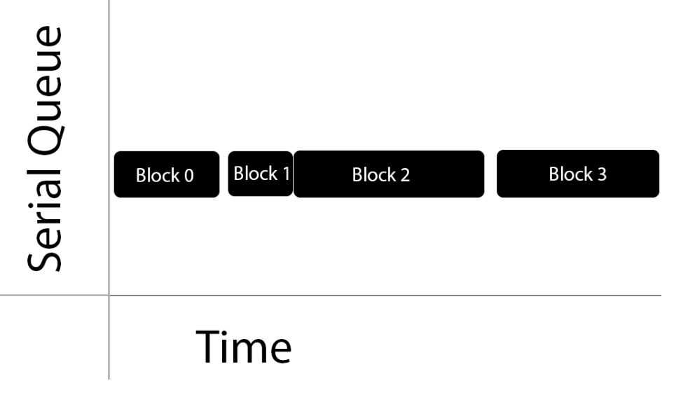
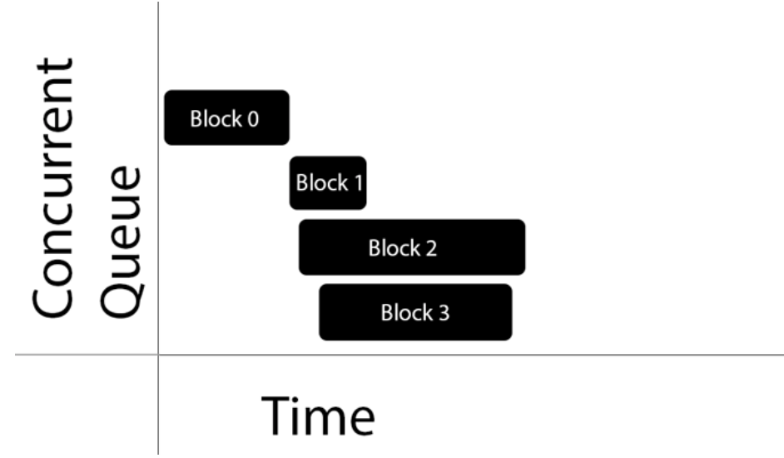
Queues
Serial
Concurrent

Slide 8
Executions
Synchronous
Asynchronous

Slide 9
Dispatch sync
Custom Serial Queue: Be VERY careful in this situation; if you're running in a queue and call dispatch_sync targeting the same queue, you will definitely create a deadlock.
Main Queue (Serial): Be VERY careful for the same reasons as above; this situation also has potential for a deadlock condition.
Concurrent Queue: This is a good candidate to sync work through dispatch barriers or when waiting for a task to complete so you can perform further processing.

Slide 10
Other tasks
Dispatch after
Dispatch once(only obj-c)
Barrier
Groups

Slide 11
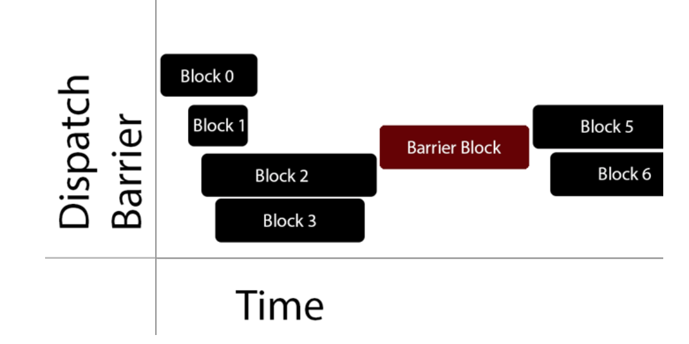
Dispatch barrier

Slide 12
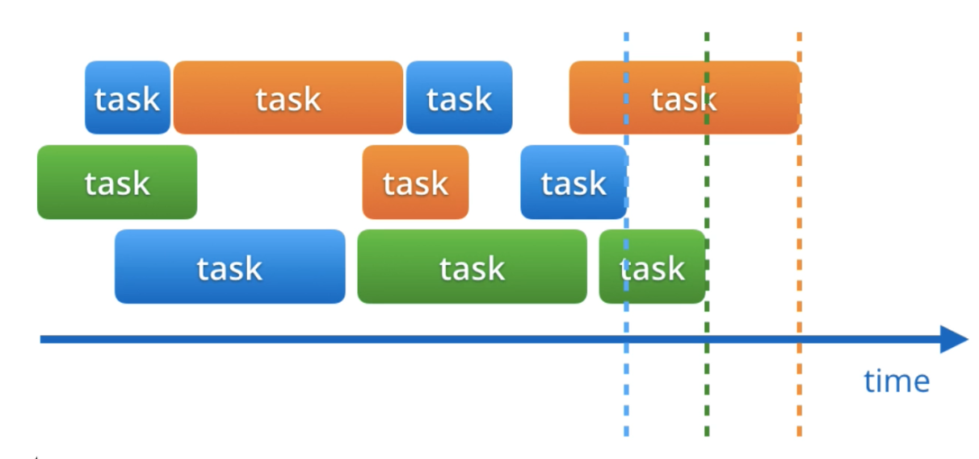
Dispatch group

Slide 13
NSOperation
NSOperation vs. Grand Central Dispatch (GCD)
Features

Slide 14
NSOperation vs. Grand Central Dispatch
GCD is a lightweight way to represent units of work that are going to be executed concurrently. You don’t schedule these units of work; the system takes care of scheduling for you. Adding dependency among blocks can be a headache. Canceling or suspending a block creates extra work for you as a developer!
NSOperation adds a little extra overhead compared to GCD, but you can add dependency among various operations and re-use, cancel or suspend them.

Slide 15
Features
Priority
Canceling
Suspending
Dependencies
Completions

Slide 16
Ready operations
NSBlockOperation
NSInvocationOperation

Slide 17
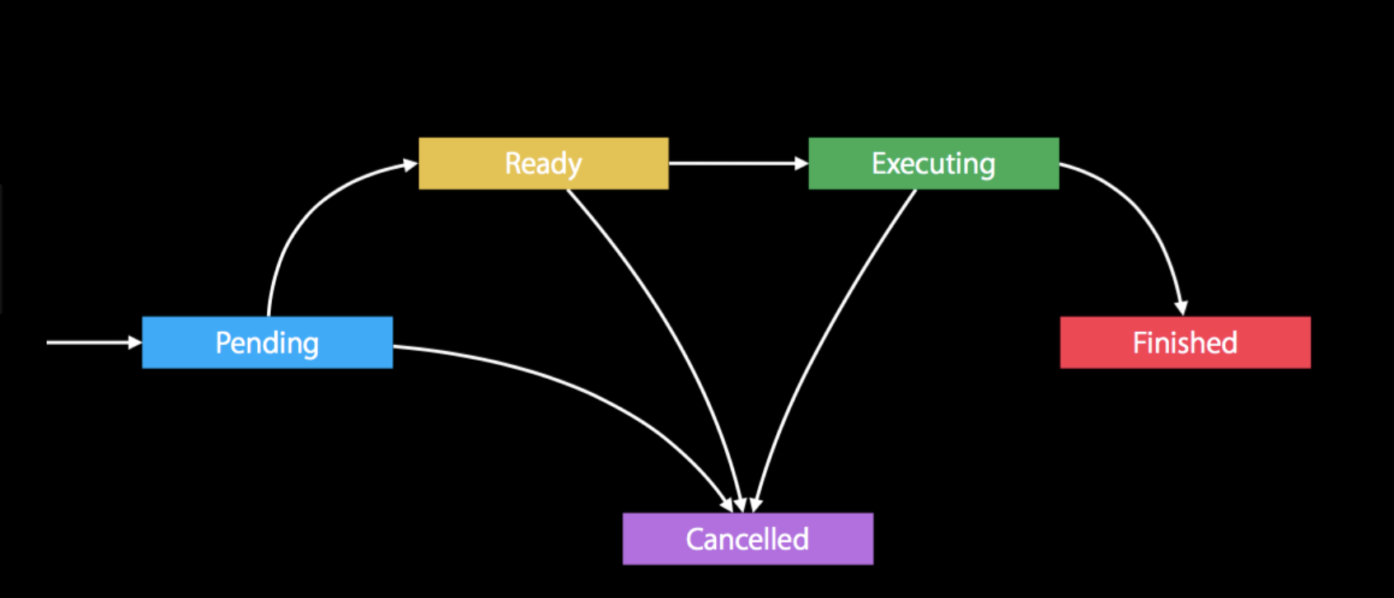
NSOperationQueue
Executes operations one by one

Slide 18
Links
http://www.appcoda.com/ios-concurrency/
https://www.raywenderlich.com/60749/grand-central-dispatch-in-depth-part-1
https://developer.apple.com/documentation/dispatch
https://developer.apple.com/documentation/foundation/nsoperation
https://developer.apple.com/documentation/foundation/nsoperationqueue?language=objc

